Slide 1




Python for
Alexa Enabled
Smart Home Programming
Ganesh Kumar T K
PyCon India 2019
Chennai, IN

Slide 2


Hello World.py
def Noob_user(Name,nick,Status):
print( "Name:", Name)
print (“About :", about)
print ("Status: ", Status)
return;
Noob_user(Name = “Ganesh Kumar ", about = “4 months old Alexa Developer. 4 year old Pythonista.", Status = "Student @ IIIT Kanchipuram")
2

Slide 3

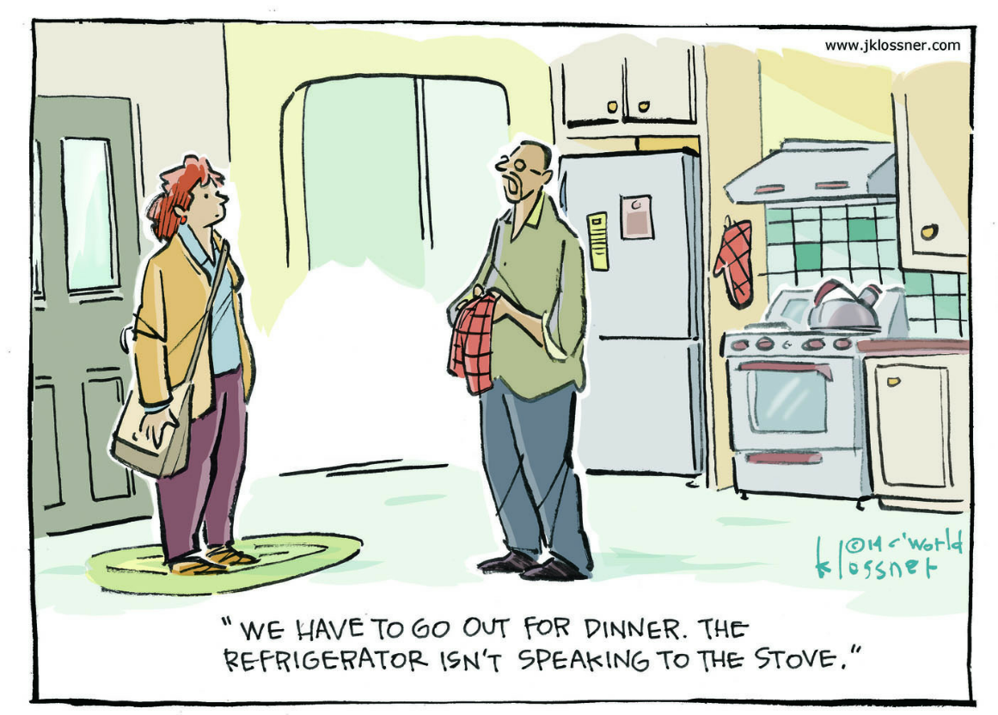
IOT
Internet of Things

Slide 4









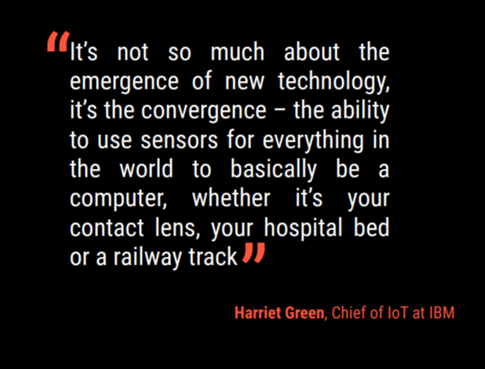




4

Slide 5






Woah!!
Total Adult
Population
252
MILLION
Smart Device
Owners
47.3
MILLION
Source: Voicebot voice shopping US Consumer Adoption and Attitudes 2018 Report
5

Slide 6

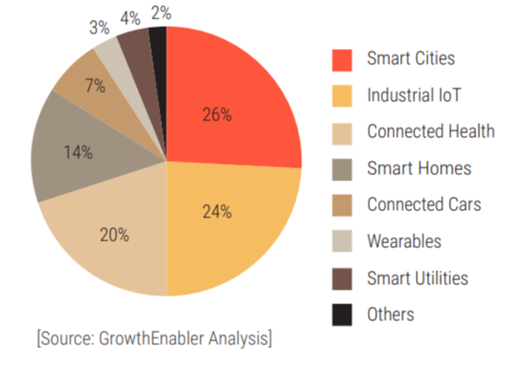
6

Slide 7

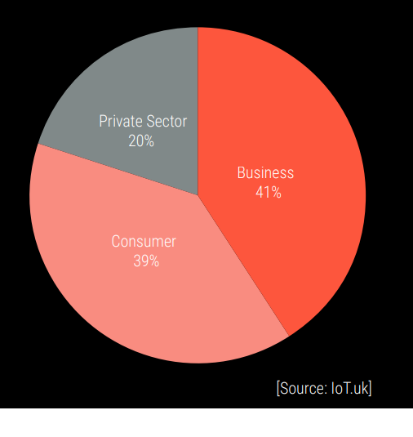
7

Slide 8



























Smart Assistants
Clippy!
Google Now
Alexa
Bixby
2011
2014
2016
2017
1996
2012
2014
2017
Siri
Cortana
Google Assistant
AliGenie
8

Slide 9











Sonos Others
Apple
4%
4% 3%
Google
27%
Amazon
62%
Source: Voicebot voice shopping US Consumer Adoption and Attitudes 2018 Report
9

Slide 10

Source: Google
10

Slide 11
Commands
11

Slide 12
Commands
Conversations
12

Slide 13












Turn off cooling
Increase the living
room temperature
slightly.
Initiate rapid
cooling mode for
all rooms
I am feeling cold /
hot
How many heaters
are on here
Optimize my room
temperature
13

Slide 14








Interactions
Light
Name
On/Off
Color
Brightness
State
Location
Alexa, initiate
night mode in
living room
14

Slide 15















Initiate home
lockdown…
Turn on the
sprinklers in the
garden…
Switch the TV
Channel to the
cricket match…
Warm up the water
in the shower..
Start vacuuming
this room…
Lower the
temperature..
Turn up the heat in
this room..
Is the front door
locked …
15

Slide 16
The Alexa
Framework

Slide 17
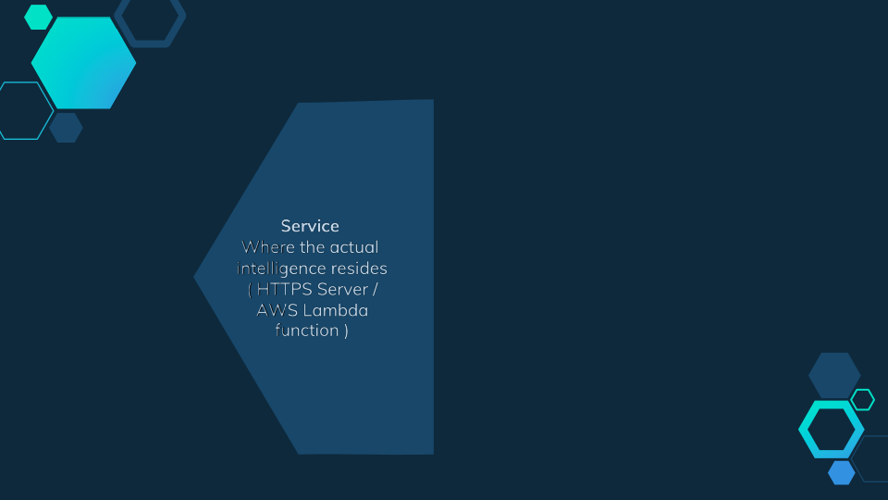



Skill
17

Slide 18







The Service
Skill
Service
18

Slide 19


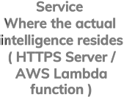



The Interface
SLOT
TYPES
Utterances
INTENT
SCHEMA
Skill
Interface
19

Slide 20
Terminologies
Building a Skill

Slide 21

Slot
“Alexa, ask Zomato for the nearest [restaurantType]”
Invocation Name
Utterance
maps to
Intent
21

Slide 22
Invocation Name
What a user must say to “start” the skill. Each skill has a
unique Invocation Name
22

Slide 23
Slot
“Alexa, ask Zomato for the nearest [restaurantType]”
Invocation Name
Utterance
maps to
Intent
23

Slide 24
Utterance
A spoken phrase that maps to an intent. A skill can
have many utterances.
24

Slide 25
Slot
“Alexa, ask Zomato for the nearest [restaurantType]”
Invocation Name
Utterance
maps to
Intent
25

Slide 26
Slot
A variable within an utterance. Variable possibilities
must be defined.
26

Slide 27
Slot
“Alexa, ask Zomato for the nearest [restaurantType]”
Invocation Name
Utterance
maps to
Intent
27

Slide 28
Intent
Whenever you speak to an Alexa Skill, your message is
mapped to an intent which decides what code to run
within your skill.
28

Slide 29
Slot
“Alexa, ask Zomato for the nearest [restaurantType]”
Invocation Name
Utterance
maps to
Intent
29

Slide 30

















Utterances
Service
Interface
Interaction Model
30

Slide 31
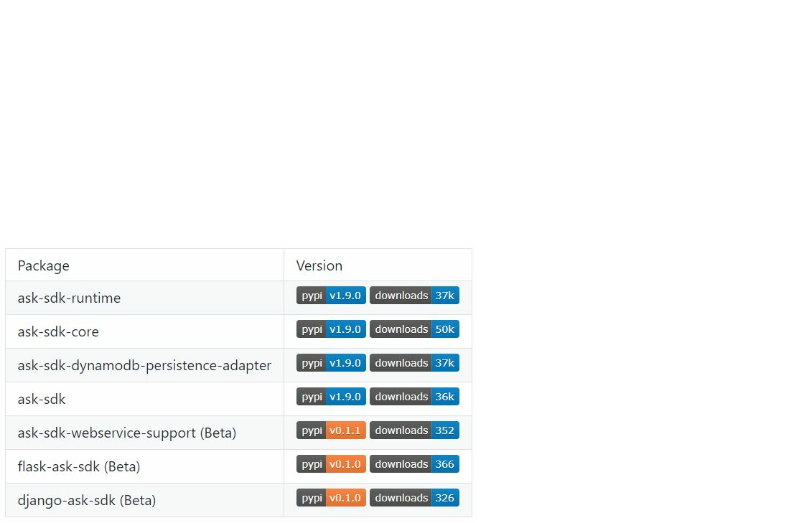
Flask-Ask
A Flask extension that has wrappers for the common constructs
for the Alexa skills API.

Slide 32
Flask-Ask
A Flask extension that has wrappers for the common constructs
for the Alexa skills API.
•
Has
decorators
to map Alexa requests
and intent
slots
to
view functions
•
Helps
construct
ask
and tell
responses,
re
-
prompts and cards
•
Makes
session management
easy
•
Allows
for
the separation of
code and speech through Jinja
templates
•
Verifies
Alexa request
signatures

Slide 33
[ Developer Experience ]
Let’s see how the code looks like.

Slide 34



ASK CLI
Initialization, clone and deploy of skill and all related resources
ask new
skill project folder
Allows you to create a skill from a
|
template, with all ﬁles needed to deploy.
|-- .ask/
|-- config
ask clone
|-- hooks/
Clones a skill present in the environment of
|-- post_new_hook.ps1
development to a local folder.
|-- pre_deploy_hook.ps1
|-- lambda/
ask deploy
|-- lambda_function.py
Loads a skill and all its resources
|-- models/
in the development environment.
|-- en-IN.json
|-- en-US.json
|-- skill.json
14

Slide 35





DynamoDB with AWS Lambda:
from ask_sdk_dynamodb.adapter
import DynamoDbAdapter, user_id_partition_keygen
def __init__(self):
dynamodb = boto3.resource(
'dynamodb',
region_name="eu-west-1",
aws_access_key_id="xxx",
aws_secret_access_key "xxx"
=
)
dynamo_client = DynamoDbAdapter(
table_name="skill-wall-street-users"
,
partition_key_name="user_id",
partition_keygen=user_id_partition_keygen,
create_table=False,
dynamodb_resource=self.dynamodb)
Saving and retrieving data
attrs = dynamo_client.get_attributes(
request_envelope=handler_input.request_envelope)
dynamo_client.save_attributes(
request_envelope=handler_input.request_envelope,
attributes={'key':'value'})

Slide 36


Custom Code
sb = SkillBuilder()
class RequestLogger(AbstractRequestInterceptor
):
""" Logs the alexa request """
def process(self, handler_input):
logger.debug(
"ALEXA REQUEST: {}".format(handler_input.request_envelope.request))
sb.add_request_handler(LaunchRequestHandler())
sb.add_request_handler(HelpIntentHandler())
sb.add_request_handler(ExitIntentHandler())
sb.add_request_handler(KpiHandler())
sb.add_global_request_interceptor(RequestLogger())
lambda_handler = sb.lambda_handler()

Slide 37











Localization and Translation
It is possible to manage the translation of a skill for the different languages ​​supported by Alexa.
The addition of supported languages ​​is done by the Developer Console.
This will automatically create language templates (JSON files) for each language.
File .py
Within the texts you can insert
SSML meta tags too, to unlock
additional features of language
in Alexa
#. NOTE: skill name
msgid "SKILL_NAME"
msgstr "<lang xml:lang='en-US'>Web Analytics</lang>"
#. NOTE: whisper response for main intent
msgid "WHISPER_RESPONSE"
msgstr "<amazon:effect name=”whispered”> Welcome
tutti</amazon:effect>
"

Slide 38
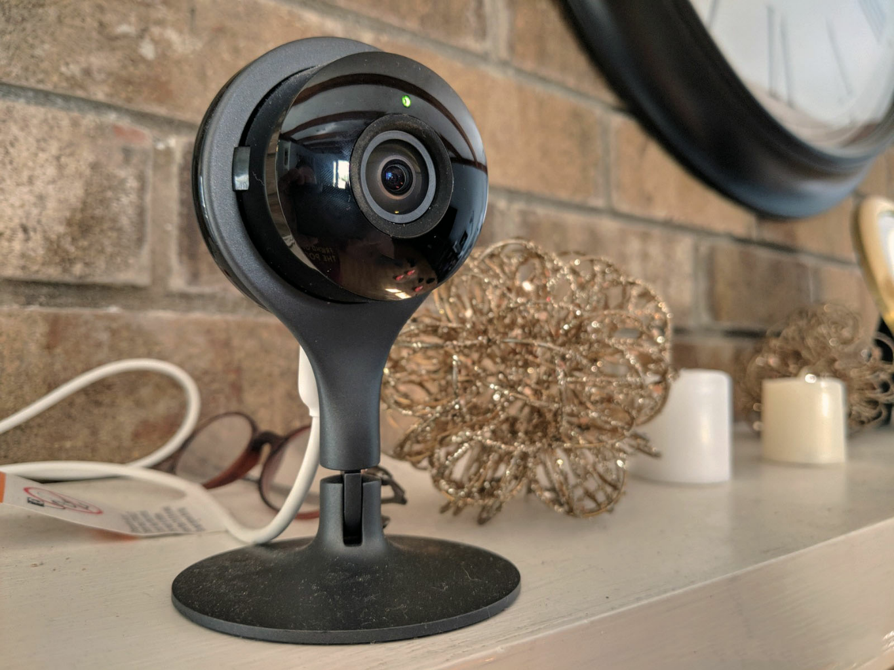
Live Deploy & Testing :
38

Slide 39

39

Slide 40
Testing a Skill

Slide 41
ngrok
exposes local servers behind NATs and firewalls to the public
internet over secure tunnels.

Slide 42
ngrok
Local http to public https!!!
•
Demoing web sites
without
deploying
•
Building webhook
consumers
on your
dev machine
•
Testing mobile apps
connected to your
locally running
backend
•
Stable addresses
for
your
connected devices
that
are
deployed in the field
•
Running personal
cloud services
from your home

Slide 43
AWS Lambda
AWS Lambda is a compute service that lets you run code without
provisioning or managing servers.

Slide 44
AWS Lambda
A compute service that lets you run code without provisioning or
managing servers.
•
Executes
your
code only when needed
•
Scales
automatically,
from a few requests
per
day to
thousands per second.
•
Charged for
compute,
not
downtime
•
Any kind of
application backend
•
build
serverless
applications
composed of
functions
that are
triggered by events

Slide 45
Alexa Skill Test

Slide 46
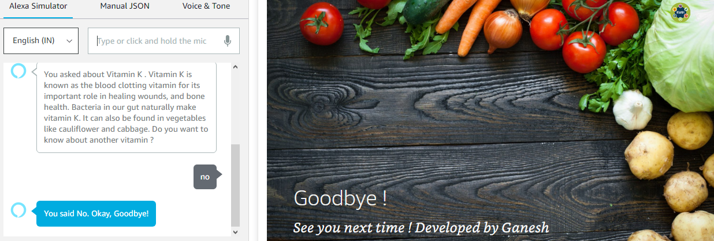
Alexa Simulator
46

Slide 47
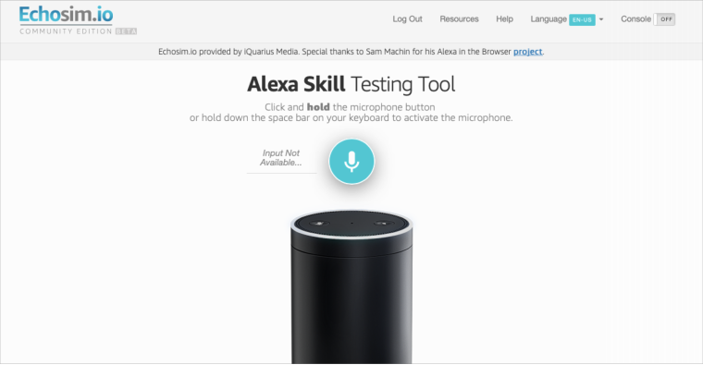
Echosim.io
47

Slide 48
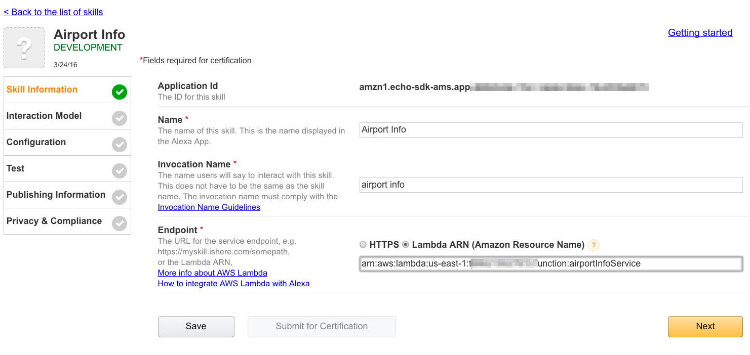
Deploying a Skill
Source: Google Images

Slide 49







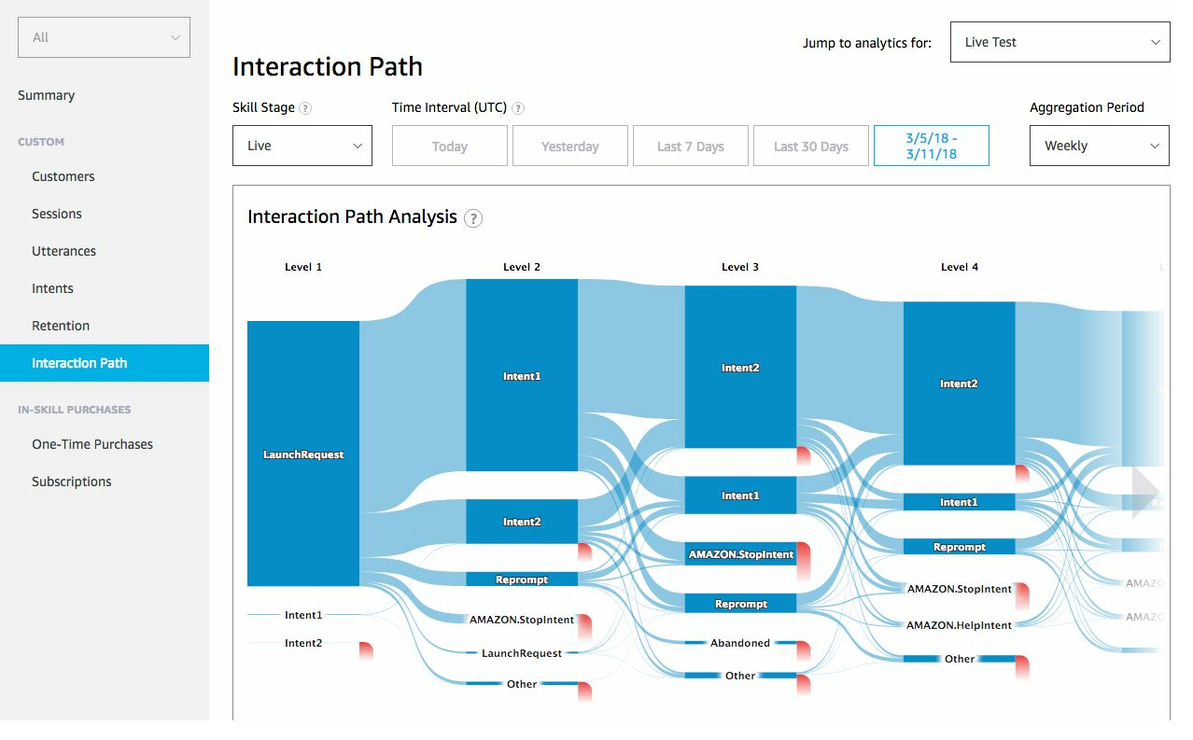
Web Analytics Skill
49

Slide 50
The Future
•
Interactive
Social
Networks
•
Interactive Idea boards
•
Voice
Gaming
•
Crisis
Alerting
•
Office Integration
–
Meeting room bookings, etc.
•
Always
aware state!!
(
Creepy!!
)
50

Slide 51
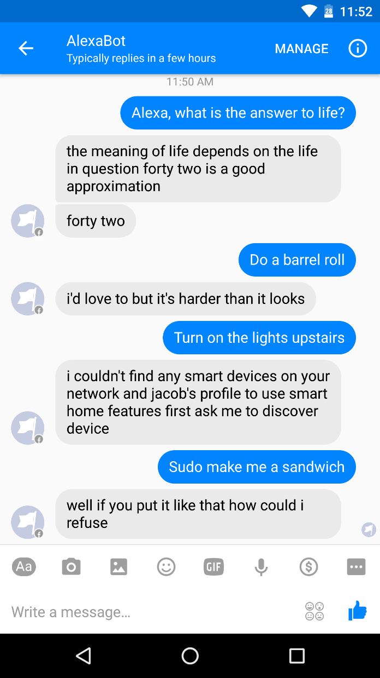
AlexaBot
51
Source: https://github.com/jacobajit/AlexaBot

Slide 52
Sources
●
https://www.theverge.com/2019/1/4/18168565/amazon-alexa-devices-how-many-sold-number-100-million-dave-limp
●
https://voicebot.ai/2018/12/24/rbc-analyst-says-52-million-google-home-devices-sold-to-date-and-generating-3-4-billion-in-2
018-revenue/
●
https://developer.amazon.com/alexaprize/challenges/current-challenge/faqs
●
https://github.com/alexa/alexa-skills-kit-sdk-for-python
●
https://medium.freecodecamp.org/how-to-create-an-alexa-skill-that-manages-to-do-lists-11c4bab29ea5
●
https://github.com/alexa/skill-sample-nodejs-petmatch/tree/master/analytics
●
https://developer.amazon.com/it/docs/account-linking/understand-account-linking.html
52

Slide 53


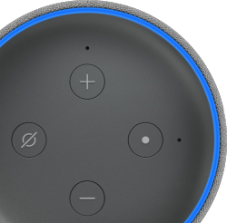
Thanks!
Questions??
You can find me at:
q ganeshkumartk@outlook.com
q coderganesh@github
q GaneshKumarTK@LinkedIn
q GaneshKumarTK's Portfolio
48

